Slide 1
Implementation of ICH E9 (R1): Estimands, intercurrent events and missing data
Ilya Lipkovich and Yongming Qu
Eli Lilly and Company
BBSW, Foster City
Nov 4, 2021
Acknowledgements: Craig Mallinckrodt, Bohdana Ratitch, Stephen Ruberg, Yu Du

Slide 2
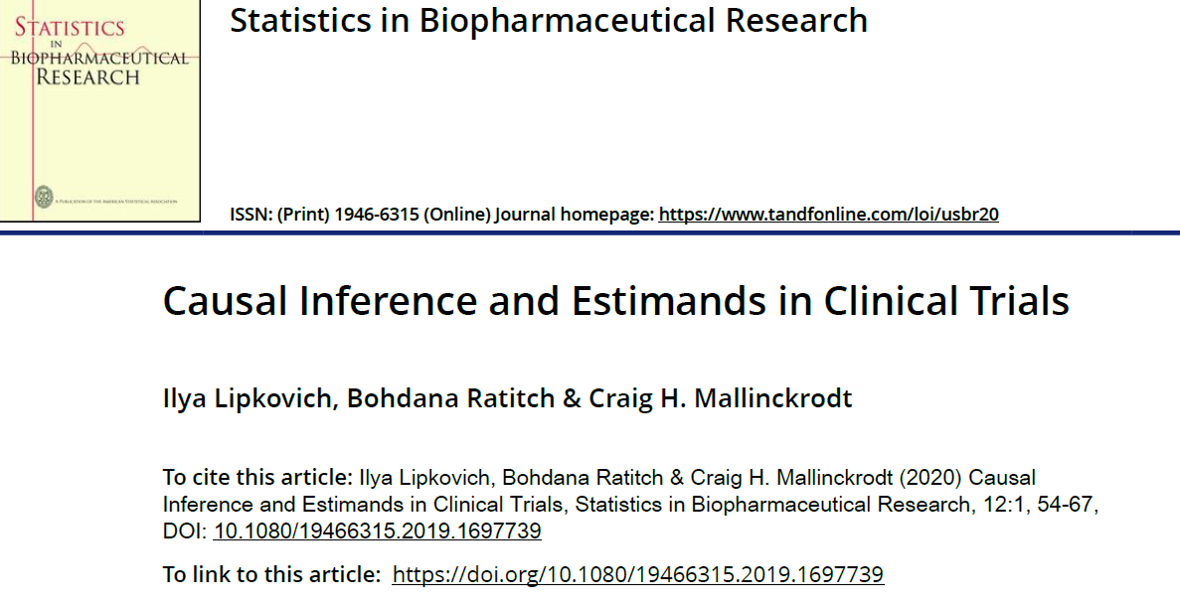
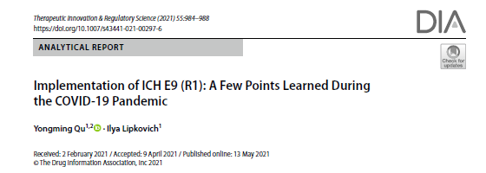
This talk is based on recent publications

Slide 3
Historical perspective: from missing data to causal estimands
Before National Research Council’s (NRC) report on treatment of missing data (< 2010)
Discussions on likelihood based repeated measures (MMRM) vs. LOCF − not always clear why LOCF is biased, as the target was not explicitly defined
Mechanism of missingness: MAR or MNAR?
Sensitivity analyses for departures from MAR: selection model, identifying influential patients
From NRC’s report to ICH E9 (R1): 2010-2017+
Put estimands first, missing data comes second
Distinguishing Study vs Treatment discontinuation: prevention of TD and encouraging data collection post TD
Sensitivity analysis: from selection model to more interpretable Pattern-Mixture Models (PMM)
not always clear whether we challenge the MAR assumption for primary estimand or propose a different estimand
ICH E9 (R1) draft addendum (2017 to 2021)
EMA Step 5, 17 Feb 2020; FDA Guidance, May 2021
Strategies for defining causal estimands …

Slide 4
ICH E9 (R1) addendum
Streamlines protocol development
The central role of estimands and strategies for dealing with intercurrent events (ICE)
ICE are defined as events occurring after treatment initiation that affect either interpretation or existence of the measurements associated with clinical questions of interest
Emphasis on causal estimands (although not mentioning “potential outcomes”)
Treatment effects are quantified by “how the outcome of treatment compares to what would have happened to the same subjects under different treatment conditions (e.g. had they not received the treatment or had they received a different treatment).”

Slide 5
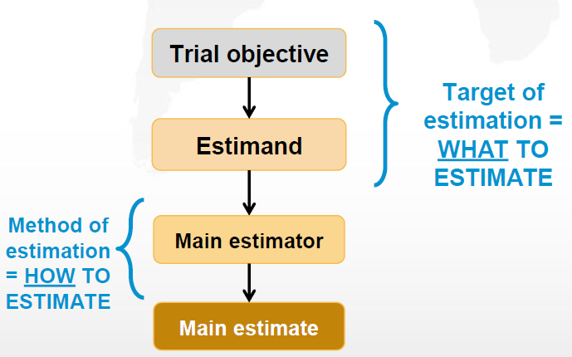
Estimand framework [ICH E9 (R1)]
Treatment(s) of interest
Population of interest
Handling of relevant ICEs
Outcome variable (endpoint) at patient level
Population-level summary
ICEs, intercurrent events

Slide 6
Strategies to handle ICEs
Treatment policy
Hypothetical
Composite variable
While on treatment (WOT)
Principal stratum (PS)
ICH E9 (R1) provides a framework for defining estimand
Key components to be considered
Treatment(s) of interest
Population of interest
Handling of relevant intercurrent events (ICEs)
Outcome variable (endpoint) at patient level
Population-level summary
ICEs, intercurrent events

Slide 7

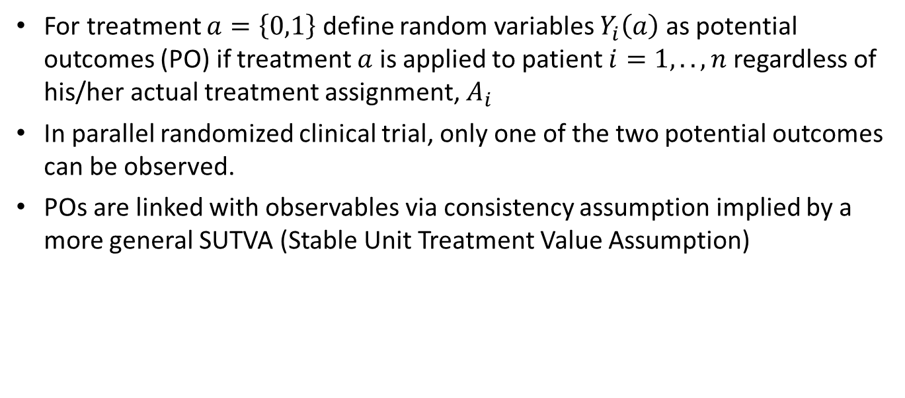
Potential Outcomes (PO) framework
For treatment $a=\left\{0,1\right\}$ define random variables $Y_{i}\left(a\right)$ as potential outcomes (PO) if treatment $a$ is applied to patient $i=1,..,n$ regardless of his/her actual treatment assignment, $A_{i}$
In parallel randomized clinical trial, only one of the two potential outcomes can be observed.
POs are linked with observables via consistency assumption implied by a more general SUTVA (Stable Unit Treatment Value Assumption)
$Y_{i}=Y_{i}\left(0\right)\left(1−A_{i}\right)+Y_{i}\left(1\right)$ $A_{i}$

Slide 8
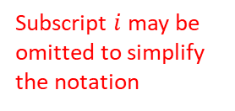
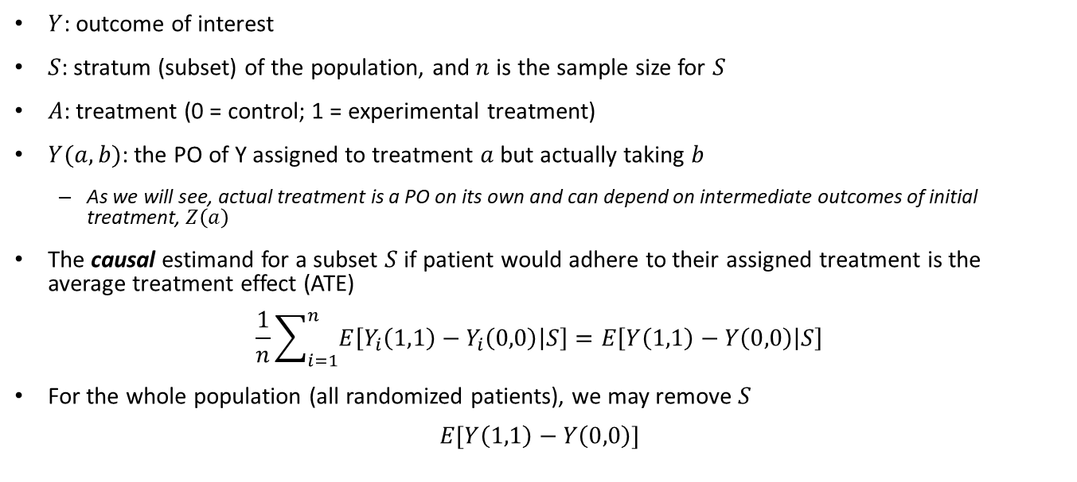
Defining estimands in presence of ICE based on PO (Lipkovich et al., 2020)
$Y$: outcome of interest
$S$: stratum (subset) of the population, and $n$ is the sample size for $S$
$A$: treatment (0 = control; 1 = experimental treatment)
$Y(a,b)$: the PO of Y assigned to treatment $a$ but actually taking $b$
As we will see, actual treatment is a PO on its own and can depend on intermediate outcomes of initial treatment, $Z\left(a\right)$
The causal estimand for a subset $S$ if patient would adhere to their assigned treatment is the average treatment effect (ATE)
$$\frac{1}{n}\sum_{i=1}^{n}{E\left[Y_{i}\left(1,1\right)−Y_{i}\left(0,0\right) | S\right]}=E\left[Y\left(1,1\right)−Y\left(0,0\right) | S\right]$$
For the whole population (all randomized patients), we may remove $S$
$$E[Y\left(1,1\right)−Y\left(0,0\right)]$$
Subscript $i$ may be omitted to simplify the notation
PO, potential outcome

Slide 9
Composite strategies
ICEs are used as part of the composite endpoint. It may be more straightforward to define the composite endpoint explicitly.
For example,
In rheumatoid arthritis (RA), the binary variable of ACR20 is often used
Composite strategy may treat a patient with an ICE of using rescue medication as a non-responder
It is more appropriate to define the endpoint as a composite endpoint “achieving ACR20 at the end of study without using rescue medications”

Slide 10
Treatment policy (TP) strategy
ICH E9 (R1) describes the TP strategy: “the occurrence of the intercurrent event is considered irrelevant in defining the treatment effect of interest: the value for the variable of interest is used regardless of whether or not the intercurrent event occurs.”
TP comes under different names and motivations
Intent to treat (ITT) – emphasizing that tested is the very fact of initial treatment assignment and ITT population
Treatment regimen – emphasizing that tested is entire treatment strategy that includes initial treatment and certain rules of treatment modification (e.g rescue)
It is often argued that TP combines the best of two worlds: RCT (randomization) and Real world (reflecting existing clinical practices, e.g. alternative/rescue medications)
In fact, it may combine the worst of the two
The visit schedules, inclusion criteria, allowed rescue medication use, etc. make a clinical trial setting drastically different from those in real clinical practice making it hard to generalize
Ignoring changes of treatments makes it hard to attribute TP effect to any particular treatment
To use TP strategy, it is recommended to clearly define the treatment regimen. For example,
The treatment of interest is the randomized study medication with any additional rescue concomitant medications based on protocol-defined rescue criteria

Slide 11

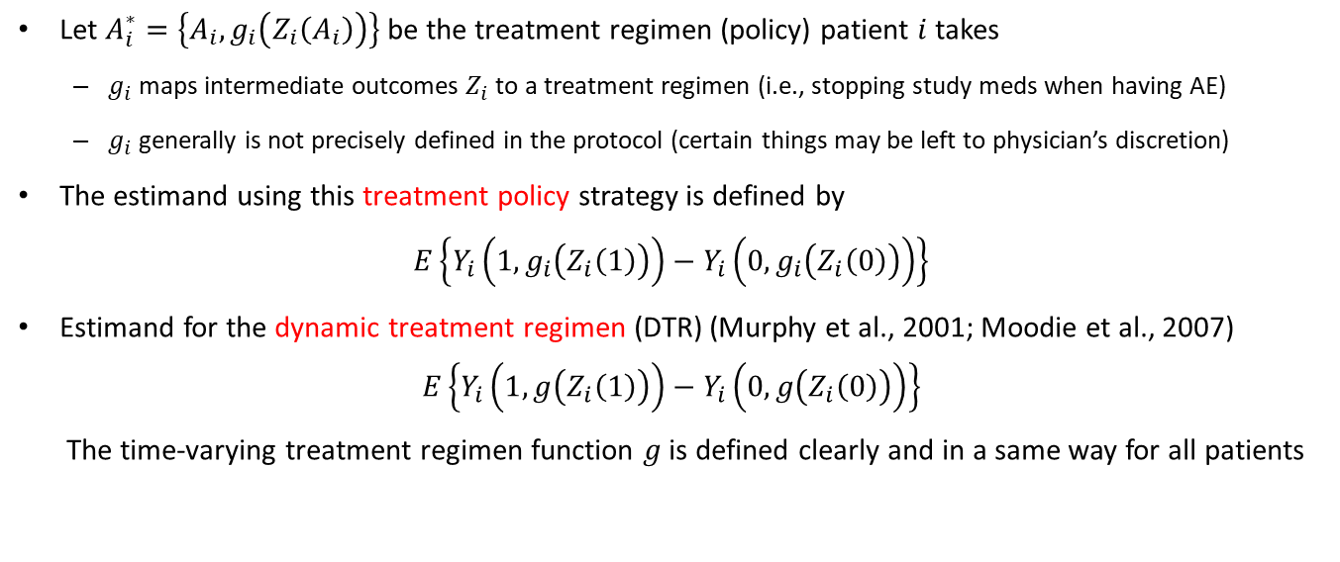

Treatment policy strategy (cont.)
Let $A_{i}^{∗}=\left\{A_{i},g_{i}\left(Z_{i}\left(A_{i}\right)\right)\right\}$ be the treatment regimen (policy) patient $i$ takes
$g_{i}$ maps intermediate outcomes $Z_{i}$ to a treatment regimen (i.e., stopping study meds when having AE)
$g_{i}$ generally is not precisely defined in the protocol (certain things may be left to physician’s discretion)
The estimand using this treatment policy strategy is defined by
$$E\left\{Y_{i}\left({1, g}_{i}\left(Z_{i}\left(1\right)\right)\right)−Y_{i}\left({0, g}_{i}\left(Z_{i}\left(0\right)\right)\right)\right\}$$
Estimand for the dynamic treatment regimen (DTR) (Murphy et al., 2001; Moodie et al., 2007)
$$E\left\{Y_{i}\left(1,g\left(Z_{i}\left(1\right)\right)\right)−Y_{i}\left(0,g\left(Z_{i}\left(0\right)\right)\right)\right\}$$
The time-varying treatment regimen function $g$is defined clearly and in a same way for all patients
$g_{i}(∙)$with subject subscript
$g(∙)$without subscript $i$

Slide 12
Hypothetical strategies
Because causal estimands should be defined in terms of potential outcomes, most strategies for handling ICEs should be “hypothetical”)
We introduce 3 different hypothetical strategies
Controlled direct hypothetical (CDH) strategy
No treatment hypothetical (NTH) strategy
Partial treatment hypothetical (PTH) strategy

Slide 13
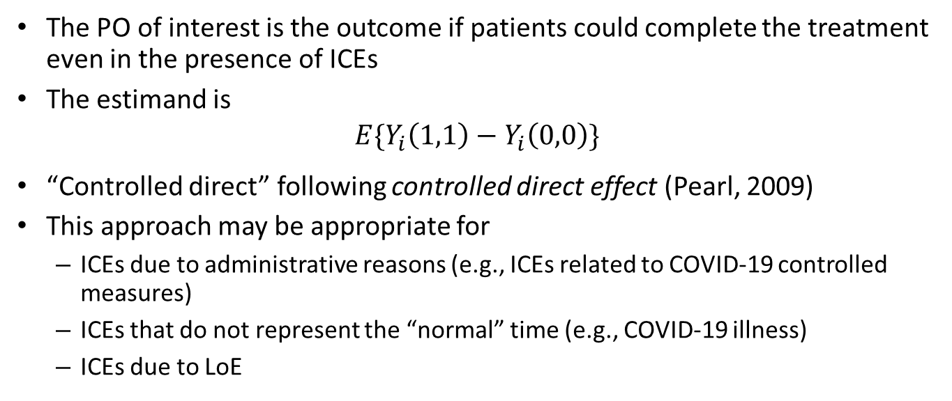
Controlled direct hypothetical (CDH) strategy
The PO of interest is the outcome if patients could complete the treatment even in the presence of ICEs
The estimand is
$${E\{Y}_{i}\left(1,1\right)−Y_{i}\left(0,0\right)\}$$
“Controlled direct” following controlled direct effect (Pearl, 2009)
This approach may be appropriate for
ICEs due to administrative reasons (e.g., ICEs related to COVID-19 controlled measures)
ICEs that do not represent the “normal” time (e.g., COVID-19 illness)
ICEs due to LoE
LoE, lack of efficacy; PO, potential outcome

Slide 14
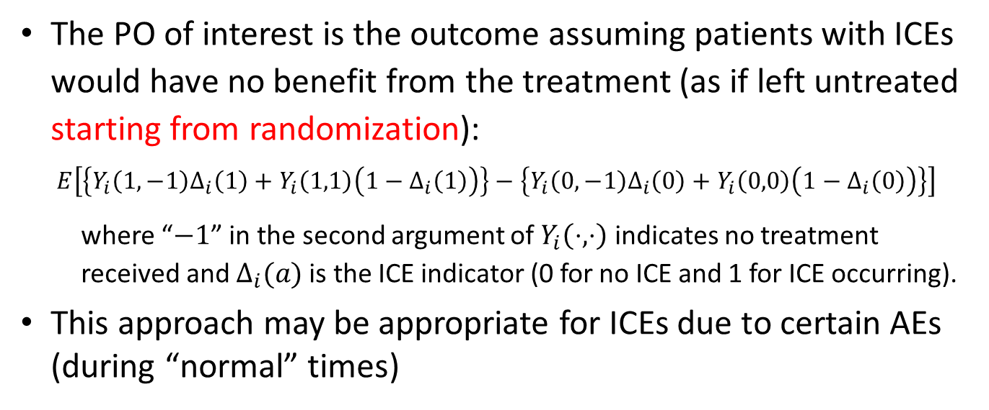
No treatment hypothetical (NTH) strategy
The PO of interest is the outcome assuming patients with ICEs would have no benefit from the treatment (as if left untreated starting from randomization):
$$E\left[\left\{Y_{i}\left(1,−1\right)Δ_{i}\left(1\right)+Y_{i}\left(1,1\right)\left(1−Δ_{i}\left(1\right)\right)\right\}−\left\{Y_{i}\left(0,−1\right)Δ_{i}\left(0\right)+Y_{i}\left(0,0\right)\left(1−Δ_{i}\left(0\right)\right)\right\}\right]$$
where “$−1$” in the second argument of $Y_{i}\left(⋅,⋅\right)$ indicates no treatment received and $Δ_{i}(a)$is the ICE indicator (0 for no ICE and 1 for ICE occurring).
This approach may be appropriate for ICEs due to certain AEs (during “normal” times)
AE, adverse event; ICE, intercurrent events; PO, potential outcome

Slide 15
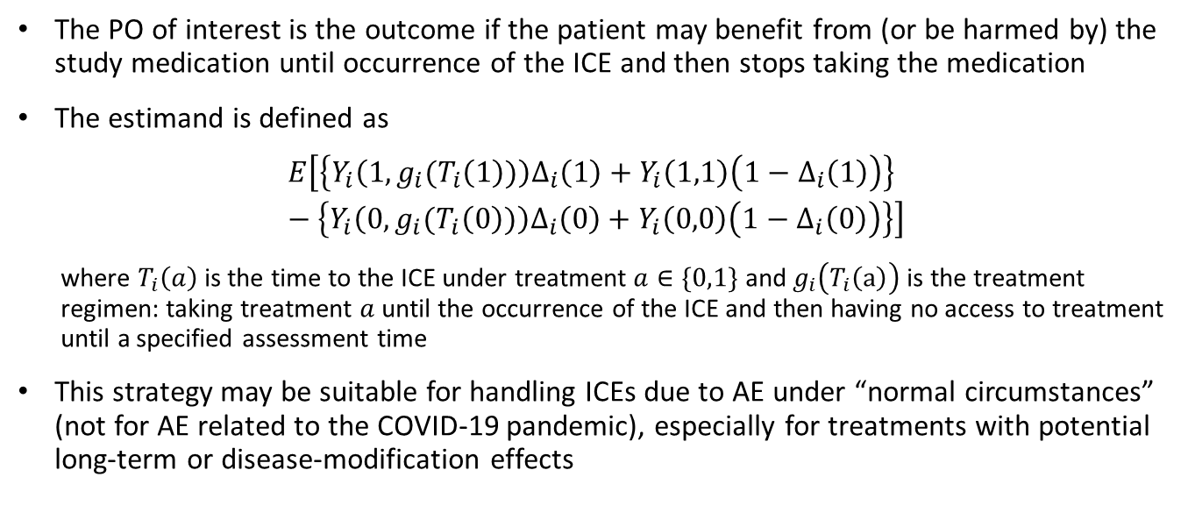
Partial treatment hypothetical (PTH) strategy
The PO of interest is the outcome if the patient may benefit from (or be harmed by) the study medication until occurrence of the ICE and then stops taking the medication
The estimand is defined as
$$E\left[\left\{Y_{i}\left(1,g_{i}(T_{i}\left(1\right))\right)Δ_{i}\left(1\right)+Y_{i}\left(1,1\right)\left(1−Δ_{i}\left(1\right)\right)\right\}−\left\{Y_{i}\left(0,g_{i}(T_{i}\left(0\right))\right)Δ_{i}\left(0\right)+Y_{i}\left(0,0\right)\left(1−Δ_{i}\left(0\right)\right)\right\}\right]$$
where $T_{i}\left(a\right)$ is the time to the ICE under treatment $a∈\{0,1\}$ and $g_{i}\left(T_{i}\left(a\right)\right)$ is the treatment regimen: taking treatment $a$ until the occurrence of the ICE and then having no access to treatment until a specified assessment time
This strategy may be suitable for handling ICEs due to AE under “normal circumstances” (not for AE related to the COVID-19 pandemic), especially for treatments with potential long-term or disease-modification effects
ICE, intercurrent events; PO, potential outcome

Slide 16
CHMP: Guideline on clinical investigation of medicinal products in the treatment or prevention of diabetes mellitus (draft)
“… Specifically, since patients are not expected to benefit once treatment is discontinued (e.g. due to adverse events) the treatment effect should be estimated based on observed or modelled data reflecting adherence to treatment as observed in the clinical trial.” PTH or NTH strategy
“… Therefore, the treatment effect can be estimated under the assumption that rescue medication, or use of other medications that will influence HbA1c values, was not introduced (hypothetical scenario), provided that a reliable estimate of that effect can be obtained.” CDH strategy

Slide 17
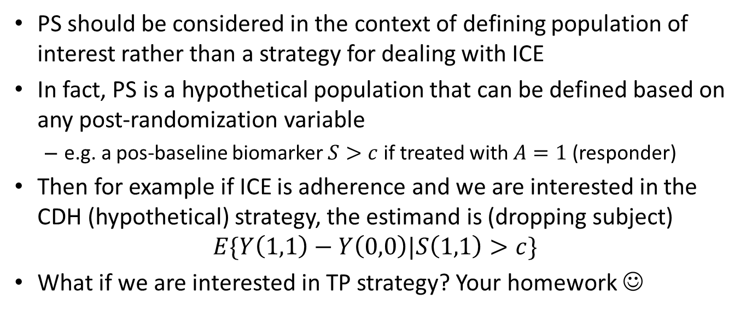
Principal stratification (PS) strategy
PS should be considered in the context of defining population of interest rather than a strategy for dealing with ICE
In fact, PS is a hypothetical population that can be defined based on any post-randomization variable
e.g. a pos-baseline biomarker $S>c$ if treated with $A=1$ (responder)
Then for example if ICE is adherence and we are interested in the CDH (hypothetical) strategy, the estimand is (dropping subject)
$$E\{Y\left(1,1\right)−Y\left(0,0\right)|S\left(1,1\right)>c\}$$
What if we are interested in TP strategy? Your homework ☺

Slide 18
Use a mix of strategies for handling ICEs in a study (Darken et al., 2020; Qu et al., 2020)
One common drawback in most current clinical studies is that only ONE strategy is used to handle all ICEs
Strategies for handling ICEs should be based on the underlying reasons
ICEs due to AE
AE at “normal time”
AE of COVID-19 illness
ICEs due to lack of efficacy (LoE)
Treatment discontinuation due to LoE
Use of rescue medication due to LoE
ICEs due to administrative reasons
Relocation, family situation changed, COVID-19 controlled measures, etc.

Slide 19
Missing values
Missing values
As a result of handling ICEs with hypothetical strategies
True missing values caused by data not being collected
Assumptions for missingness and methods for handling missing values should be based on the underlying reasons of ICEs or missingness
ICEs due to AE
AE at “normal circumstances”
AE of COVID-19 illness
ICEs due to LoE
ICEs due to administrative reasons
Not due to ICEs
AE, adverse event; ICEs, intercurrent events; LoE, lack of efficacy

Slide 20
Understand the potential outcome before imputing
O: measurement available
? : measurement missing
X: treatment discontinuation
◊: Use of rescue medication
Dropout: study discontinuation
Dropout
O
O
O
X
O
◊
O
?
O
O
O
X
O
Dropout
?
O
O
O
◊
O
O
Randomization
Last scheduled visit
What is the potential outcome of interest at last scheduled visit?
The potential outcome of not taking study medication but using rescue medication
The potential outcome of not taking study medication and not using rescue medication (having no access to treatment)
The potential outcome of continuing to taking study medication rather than using rescue medication

Slide 21
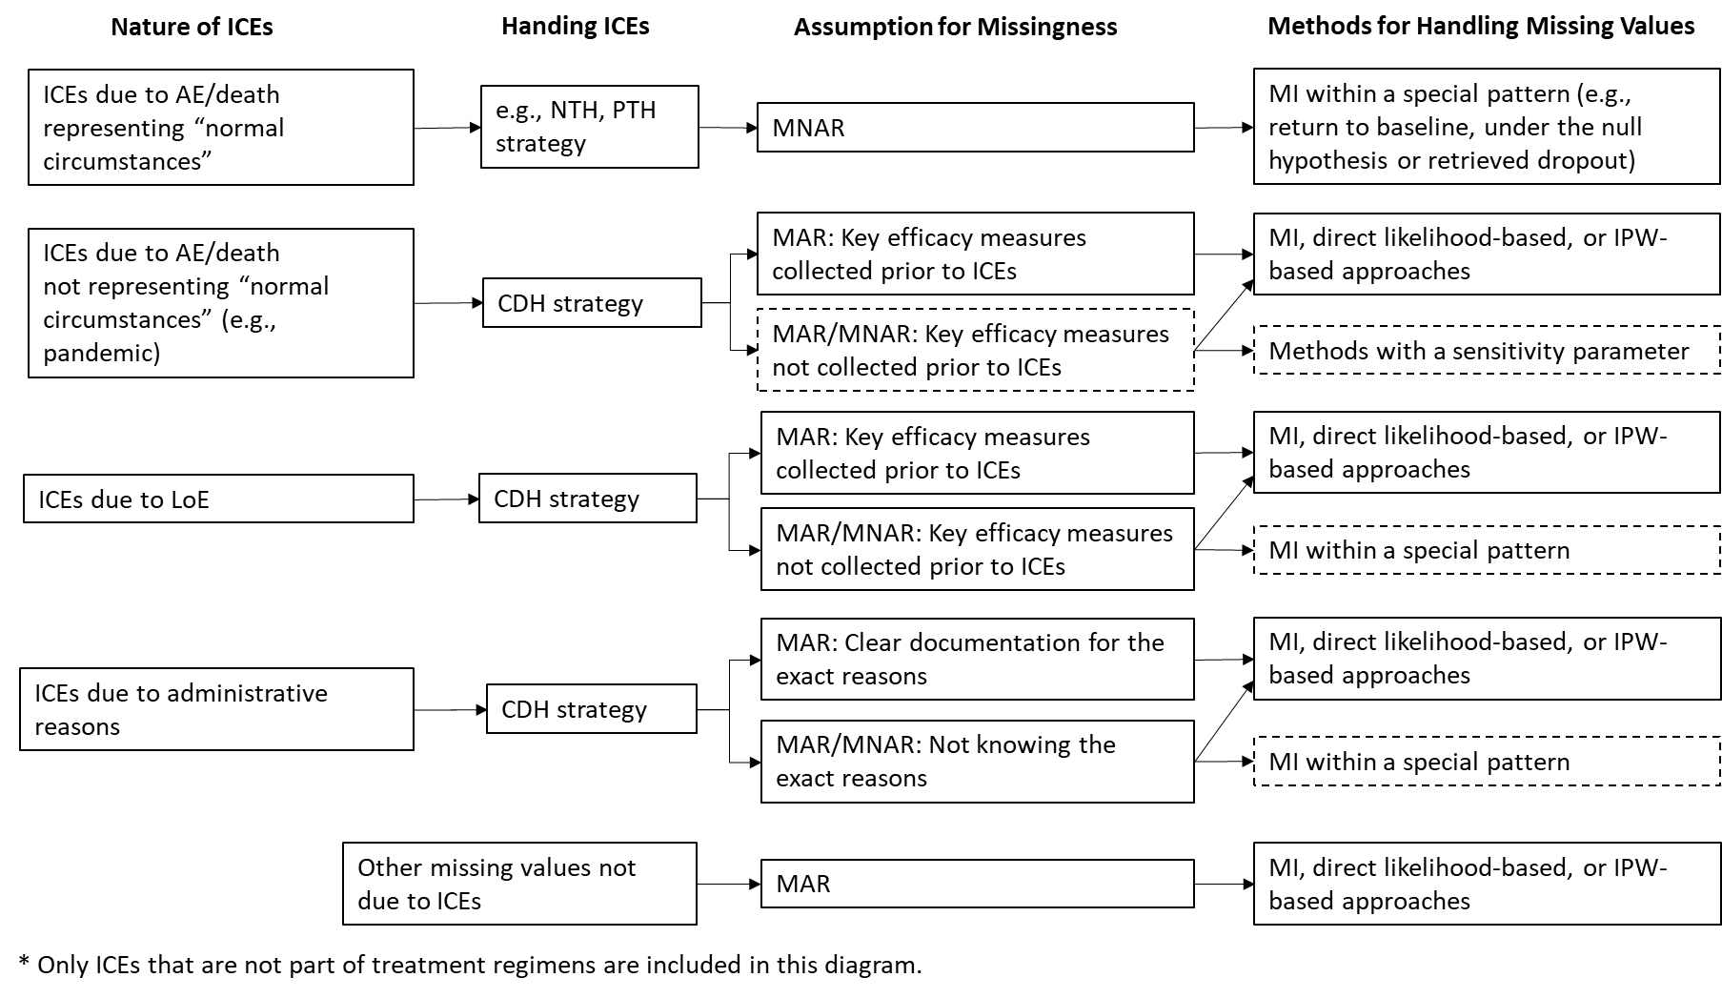
Handling ICEs and missing values according to the nature of ICE/missingness
AE, adverse event
CDH, controlled direct hypothetical
ICEs, intercurrent events
IPW, inverse probability weighting
LoE, lack of efficacy;
MAR, missing at random
MI, multiple imputation
MNAR, missing not at random
NTH, no treatment hypothetical
PTH, partial treatment hypothetical

Slide 22
Summary and Recommendations
Describing estimands
Using PO language may help define and communicate estimands more succinctly. It also helps evaluate the plausibility of certain strategies for handling ICEs
Defining ICEs
Prior to identifying possible ICEs, treatment regimens of interest need to be defined precisely
To be considered an ICE, this event should be a deviation from the treatment regimens of interest
Handling ICEs
If intending to use a composite strategy to handle certain ICEs, these ICEs should be explicitly included in the composite endpoint
Hypothetical strategies should be predominately used to define causal estimands
Using a mix of strategies (rather than a single strategy) for handling ICEs is often clinically relevant.
Estimation
Multiple imputation is a flexible tool allowing for implementing a mix of strategies for handling ICEs
Use the most plausible assumptions (not the most conservative assumptions)

Slide 23
References
Bergenstal, R. M., Lunt, H., Franek, E., Travert, F., Mou, J., Qu, Y., ... & Bastyr III, E. J. (2016). Randomized, double‐blind clinical trial comparing basal insulin peglispro and insulin glargine, in combination with prandial insulin lispro, in patients with type 1 diabetes: IMAGINE 3. Diabetes, Obesity and Metabolism, 18(11), 1081-1088.
Darken, P., Nyberg, J., Ballal, S., & Wright, D. (2020). “The attributable estimand: A new approach to account for intercurrent events”. Pharmaceutical Statistics 19(5): 626-635.
ICH E9 (R1) (2019). “ICH Harmonised Guideline Addendum on Estimands and Sensitivity Analysis in Clinical Trials to the Guideline on Statistical Principles for Clinical Trials E9(R1) ,” International Conference on Harmonisation [online], Available at https://database.ich.org/sites/default/files/E9-R1_Step4_Guideline_2019_1203.pdf.
Hernán MA and Scharfstein D (2018) Cautions as regulators move to end exclusive reliance on Intention to Treat. Annals of Internal Medicine, 168, 515–516
Lipkovich, I., Ratitch, B., & Mallinckrodt, C. H. (2020). Causal inference and estimands in clinical trials. Statistics in Biopharmaceutical Research, 12(1), 54-67.
Little, R. J. A. (1995), “Modeling the Drop-Out Mechanism in Repeated Measures Studies,” Journal of the American Statistical Association, 90, 1112–1121.
Meyer, R. D., Ratitch, B., Wolbers, M., Marchenko, O., Quan, H., Li, D., ... & Englert, S. (2020). Statistical Issues and Recommendations for Clinical Trials Conducted During the COVID-19 Pandemic. Statistics in Biopharmaceutical Research, (just-accepted), 1-22.
Neyman, J. (1923), “On the Application of Probability Theory to Agricultural Experiments. Essay on Principles. Section 9,” Statistical Science, 5, 465–480.
Pearl, J. (2009), “Causal Inference in Statistics: An Overview,” Statistics Surveys, 3, 96–146.
Qu, Y., Shurzinske, L., & Sethuraman, S. (2020). Defining estimands using a mix of strategies to handle intercurrent events in clinical trials. Pharmaceutical Statistics. DOI: 10.1002/PST.2078
Ratitch B, Bell J, Mallinckrodt C, Bartlett JW, Goel N, Molenberghs G, O'Kelly M, Singh P, and Lipkovich I (2019) Choosing estimands in clinical trials: putting the ICH E9(R1) into practice. Therapeutic Innovation & Regulatory Science 54(2):324-341
Rubin, D. B. (1978), “Bayesian Inference for Causal Effects: The Role of Randomization,” Annals of Statistics, 6, 34–58.
Rubin, D. B. (1987), “Multiple Imputation for Nonresponse in Surveys”, New York: Wiley.

Slide 24
Thank you!
Q & A

